Slide 1
UGBA 141 Production and Operations Management
Strategy I Revenue Management and Pricing
Professor Park Sinchaisri
Notes:
Agenda
Capability Analysis + Six Sigma
Ritz-Carlton Case
Service Excellence

Slide 2
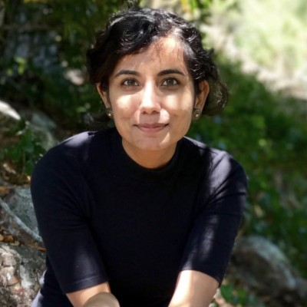
Course Announcements
Agenda: Revenue Management + Guest Speaker: Upasna Sharma (Uber)
Tomorrow: Project Presentation slides due 11:59pm
Wednesday: Project Presentations, 7 mins/team
Friday: Discussion reviews today’s materials + final #1
+ Littlefield Team Strategy 4 Slides (ppt only) due 11:59pm
Next week: Monday = Littlefield Debrief + PM + Final info
Tuesday = HW5 due (optional if you did HW4)
Wednesday = Wrap-up + Final Flash Review (+ bonus points)
Notes:
https://docs.google.com/presentation/d/1s3d6tfGF5RtBGoeew5_DZvjw69gzU8qnci-k0GJFwtE/edit#slide=id.g124c74e1488_0_0

Slide 3
Reminders
Tuesday: Submit Project Slides (ppt/pdf) by 11:59pm
Grading criteria in email/on bCourses/Assignments
Motivation, approach(es), actional, connections
Wednesday: Project Presentation (7 mins) + 1 Q&A
Friday: Littlefield Strategy Slides (ppt only) due 11:59pm
4 slides: machine purchase / Q / R / end game
Put explanations in notes, Details in handout/bCourses
Debrief Mon 4/25, random one slide from each team

Slide 4
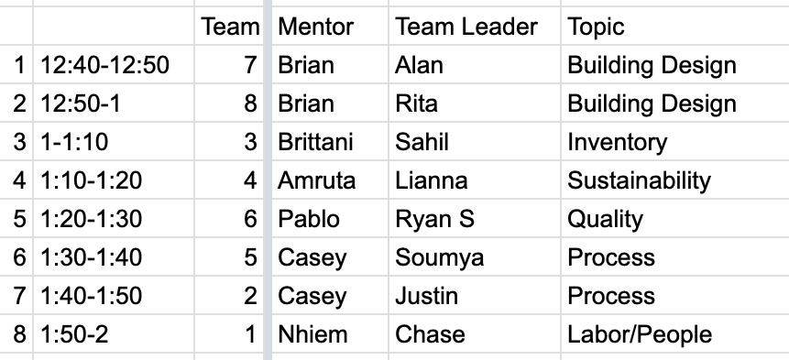
Project Presentations

Slide 5
Matching Supply with Demand When Supply is Fixed
Revenue management is a solution:
If adjusting supply is impossible – adjust the demand!
Segment customers into high willingness to pay (WTP) and low willingness to pay
Limit the number of tickets sold at a low price, i.e., control the average price by changing the mix of customers
Examples of fixed supply:
Airlines
Hotels
Car rental
Cruise line
Advertising time (limited number of slots)

Slide 6
RM: Protection Levels + Booking Limits

Slide 7
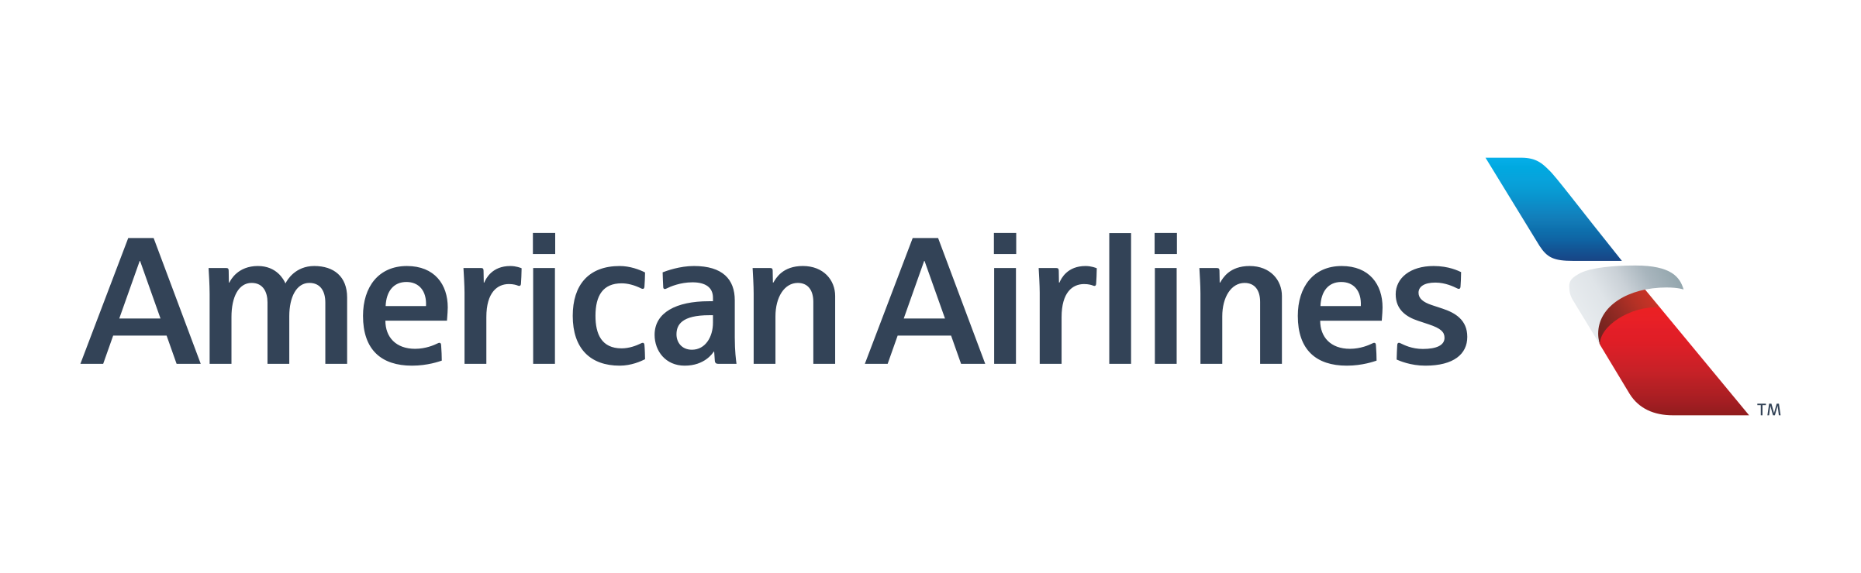
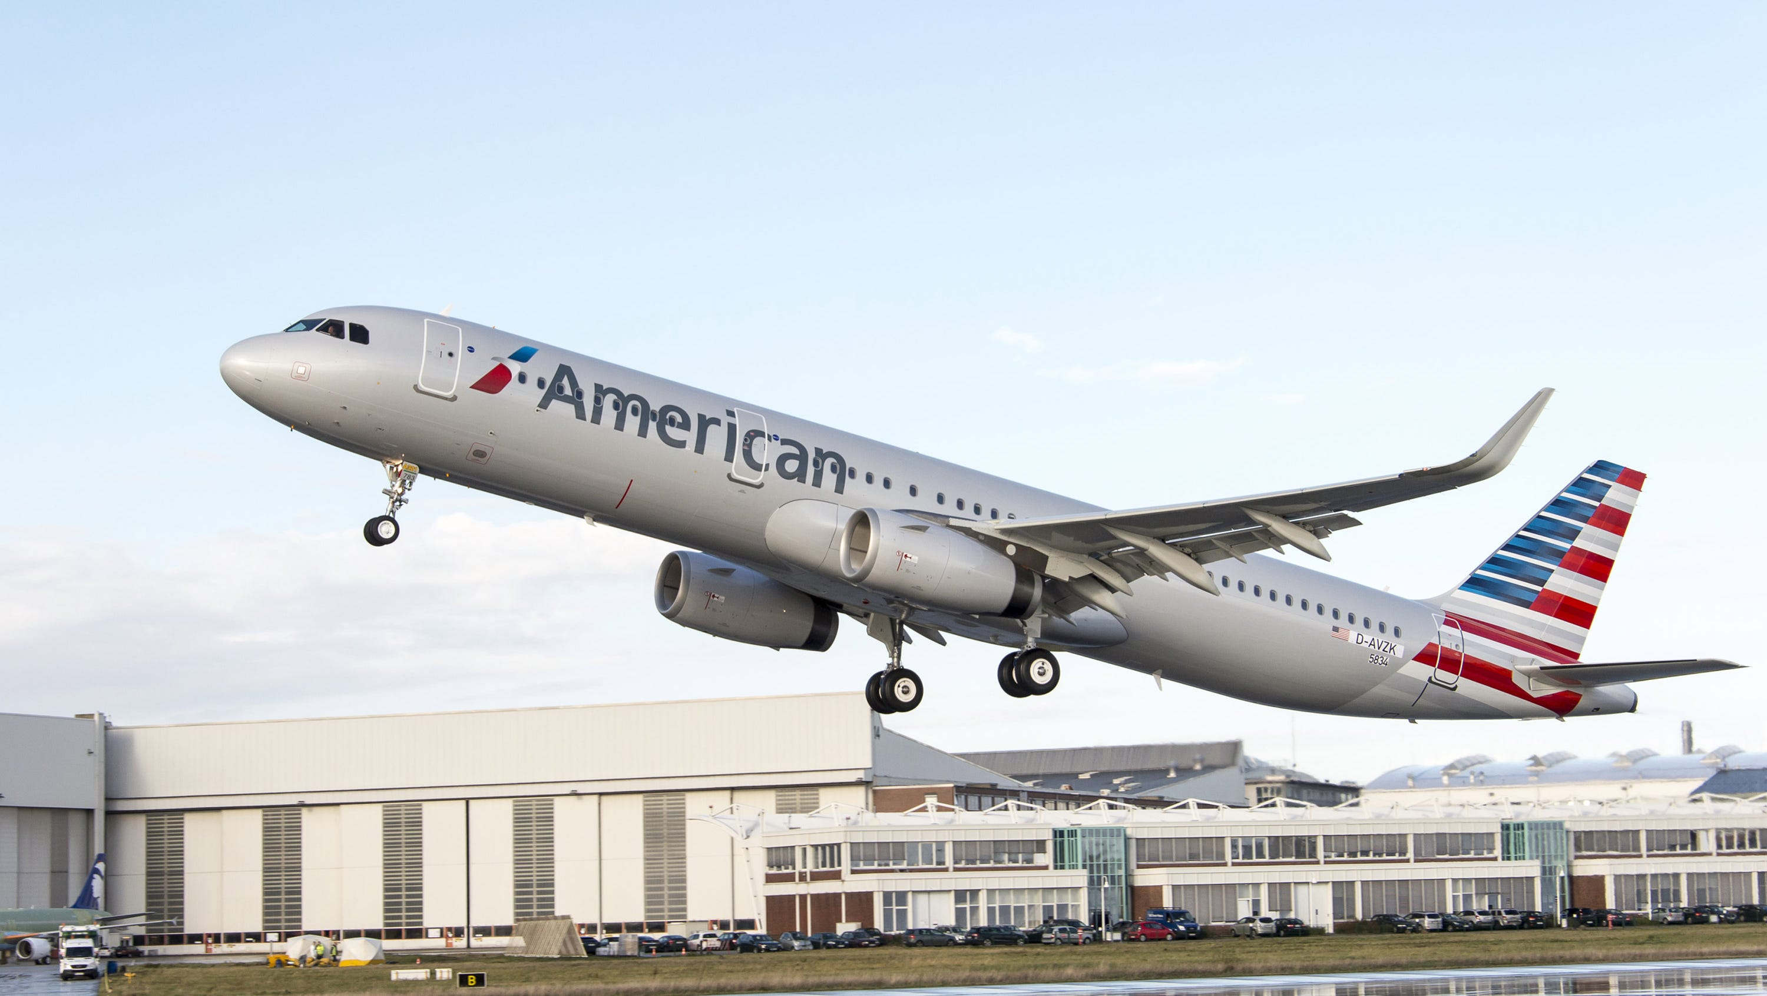
Two-Fare Airline Pricing
Fare classes
Low fare: Discounted price of $228 for restricted advance-purchase ticket targeting leisure travelers
High fare: Regular price of $659 for unrestricted ticket targeting business travelers
Demand assumptions
Demand for low-fare tickets is abundant
Demand for high-fare tickets is normally distributed with mean 40 and standard deviation 20
Most of the high-fare (business) demand occurs only within a few days of the actual flight
Flight AA234
SFO → New York JFK
138 coach seats
Objective: Maximize expected revenues by controlling the # of low-fare seats you sell

Slide 8
Protection Level
Let Q be the protection level for the high-fare class
This protection level is in effect while you sell low-fare tickets
The booking limit on the low-fare class is 138 – Q:
You will sell no more than 138 – Q low-fare tickets because you are protecting (or reserving) Q seats for high-fare passengers
Protection level Q is the number of seats you reserve for the high-fare class
Booking limit is the number of seats you are willing to sell to low-fare customers
0
138
Sell no more than the low-fare booking limit, 138 – Q
Q seats protected for
high-fare passengers

Slide 9
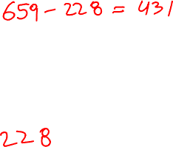
Protection Level Marginal Analysis
Case 1: We allocated a seat to the high-fare class and we sold it.
How much did we gain relative to the case where we
did not allocate the seat to the high-fare class?
G =
Case 2: We allocated a seat to the high-fare class and we did not sell it.
How much did we lose relative to the case where we
did not allocate the seat to the high-fare class?
L =

Slide 10
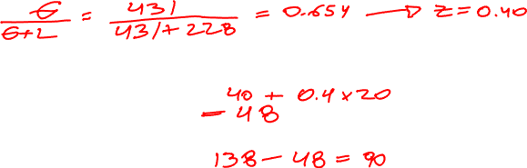
Optimal Protection Level
How many seats should we protect for high-fare customers?
protection level =
How many seats will we be willing to sell to low-fare customers?
booking limit =
How would your answer change if… | Change in protection level | Explanation
…high fare decreased? | Decrease | Each high-fare customer is less valuable (smaller gain “G”)
…high fare (mean) demand increased? | Increase | Each seat protected for a high-fare customer is more likely to be filled

Slide 11

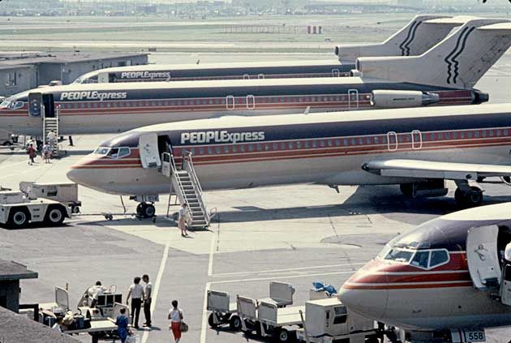
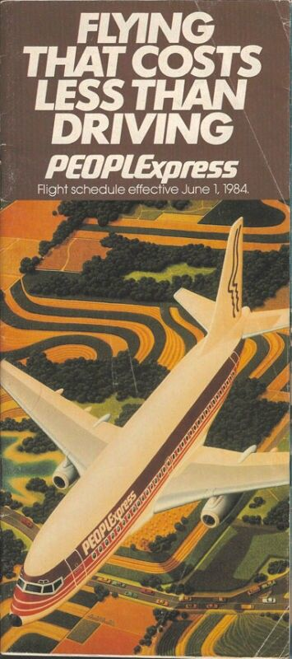
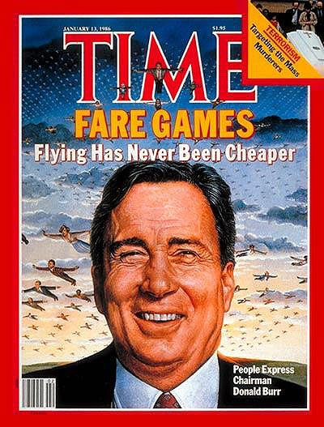
Case Study
PeopleExpress was a growing, profitable, “low-fare” airline in the early 1980s.
In 1984 (before RM), PeopleExpress entered key markets for American Airlines with cut-rate fares.
American responded with Revenue Management: capacity-controlled, discounted fares.
Almost immediately, PeopleExpress started incurring losses. Within 18 months, PeopleExpress was bankrupt.

Slide 12
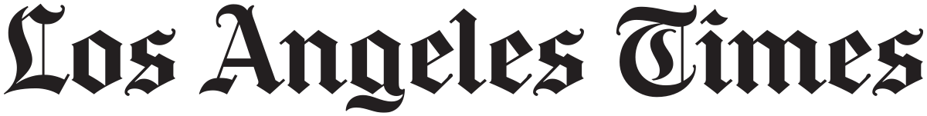
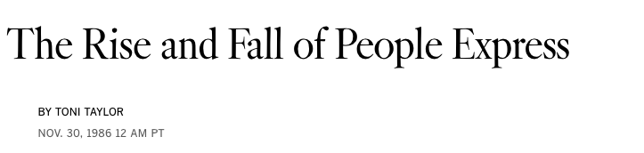


Case Study
“We were a vibrant, profitable company from 1981 to 1984, and then we tipped right over into losing $50 million a month. We were still the same company.
What changed was American’s ability to do widespread Revenue Management in every one of our markets.
We had been profitable from the day we started until American came at us with Super Savers [capacity-controlled, discounted fares]. That was the end of our run because they were able to under-price us at will and surreptitiously.”
- Donald Burr, CEO of PeopleExpress

Slide 13
Protection Level When to Use
The same unit of capacity (e.g., airline seat, hotel room, rental car) can be used to deliver services to different customer segments (e.g., business vs leisure customers) at different prices
Perishable capacity (it cannot be stored) and limited capacity (all possible customers cannot always be served)
Capacity is sold in advance of demand
There is an opportunity to segment customers (so that different prices can be charged) and different segments are willing to pay different prices

Slide 14
RM: Overbooking

Slide 15
Cancellations/No-shows
Cancellations and no-shows are common
Approximately 50% of reservations get cancelled at some point in time
No-show rates in hotels 7% to 20% depending on category
In many cases (car rentals, hotels, full-fare airline passengers) there is no penalty for cancellations
Problem: The company may fail to fill the seat (room, car) if the passenger cancels at the very last minute or does not show up
Solution: Sell more seats (rooms, cars) than capacity
“Overbooking”
Danger: Some customers may have to be denied a seat even though they have a confirmed reservation

Slide 16
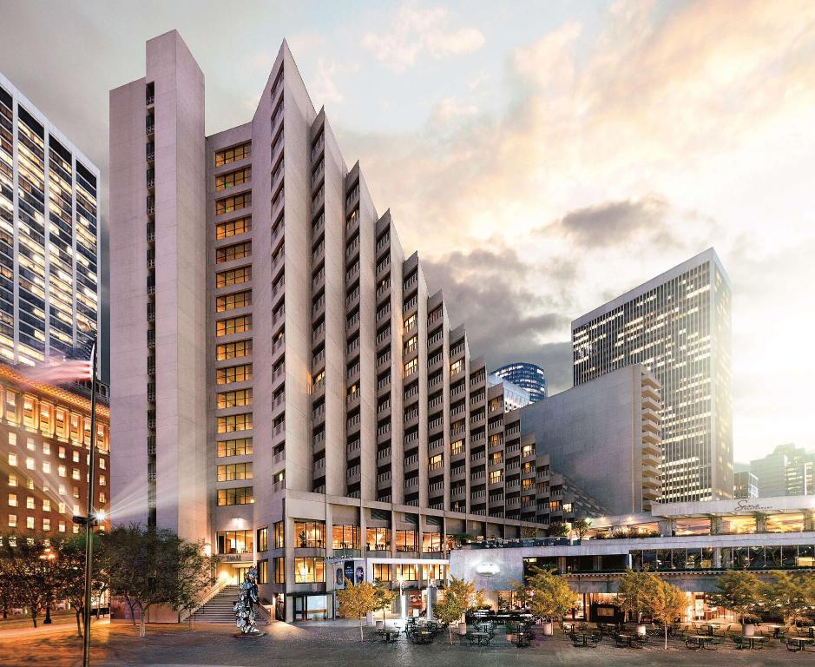
Overbooking
Hyatt Regency San Francisco
802 King/Queen Rooms, Rate is $242 /night
The cost of denying a room to the customer with a confirmed reservation (“walking” a customer) is estimated to be $500 in ill-will and penalties
For simplicity, assume the cost of cleaning a used room is insignificant
How many rooms should be overbooked (sold in excess of capacity)?
→ Pre-commitment under uncertainty = Newsvendor logic!
G = $242 ← This room would have been empty, but now we earn revenue
L = $500 ← No room for this 6th guest; incurs cost of denying a guest
Critical ratio → z* → Optimal Q = mean no shows + z* (SD no shows)

Slide 17
Optimal Overbooking
The forecasted number of no-shows, based on historical data, is normally distributed with mean 40 and standard deviation 20
How many rooms should be overbooked (sold in excess of capacity)?
G/(G+L) = 0.326 → z = 0.45
→ Overbook = 40 - 0.45x20 = 31 rooms
If you overbook this number of rooms, what is the probability you will have to walk a customer?
Service level 32.6%

Slide 18
Overbooking When to Use
Perishable capacity (it cannot be stored) and limited capacity (all possible customers cannot always be served)
Capacity is sold in advance of demand
The cost of denying service to a customer with a reservation is “relatively low”
yes
no
Business hotels
Rental cars
Passenger airlines
Resort hotels
Cruise lines

Slide 19
Revenue Management Summary
Protection levels and overbooking give demand flexibility where supply flexibility is not possible
The essential logic = Newsvendor logic (decision in the face of uncertainty), although in practice RM systems are more complex (multiple classes, dynamically set protection levels)
Powerful tool to improve revenue that is widely used in industries:
Airlines: Revenue gains from revenue management are significant (about 4% to 5% of revenues)
Marriott attributes $100 million in additional annual revenue
Turnaround of National Car Rental from brink of liquidation to two-year later sale by parent GM for $1.2 billion attributed to RM

Slide 20


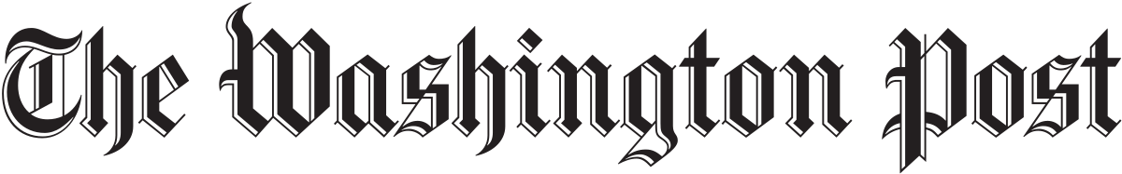



Guest Speaker: Upasna Sharma
Product Lead
Previously at
Notes:
Upasna leads the Membership Growth Product Management team at Uber. Previously, she led the Driver Incentives PM team at Uber, worked on pricing at Walmart eCommerce, did tech consulting for Deloitte, and worked at a 10 person startup in NYC where she was their 8th employee. Upasna hails from New Delhi, India, and graduated from Harvard University with a Bachelors degree in Applied Mathematics. She enjoys comics and social theory. Starting tomorrow, she's taking a career sabbatical for the next 3 months, where she's excited to "not achieve", and suck the marrow out of life outside work.
When I joined the team, I was the only PM on Eats Pass. I co-defined Uber's global Membership strategy, and built the case for why Uber should invest in Membership, culminating in C-suite sign-off. Then, I led the Membership Growth + Retention teams, built our growth playbook, and hired a team of 3 Product Managers, who worked with a ~60 person XFN tech team to launch several products from inception to global scale. Previously, I worked on building a more efficient marketplace, through identifying, communicating, and optimizing opportunities for our driver partners to earn extra during busy times and geos, globally.

Slide 21

What’s Next
Tomorrow: Project Presentation slides due (pdf/pptx)
Wednesday: Project Presentations, 7 minutes/team
Friday: Discussion reviews today’s materials + final part 1
+ Littlefield Team Strategy Slides due (pptx only)
Next Monday: Littlefield Debrief + Product Management
Read IDEO
Next Tuesday: HW5 due
Next Wednesday: Wrap-up + Final Flash Review (+ earn bonus points)
Next Friday: Discussion reviews final part 2

